Slide 1
Materials Selection
MSEG 302 Spring 2018

Slide 2
The world of materials
Steels
Cast irons
Al-alloys
Metals
Cu-alloys
Ni-alloys
Ti-alloys
PE, PP, PC
PA (Nylon)
Polymers,
elastomers
Butyl rubber
Neoprene
Alumina
Si-Carbide
Ceramics,
glasses
Soda-glass
Pyrex
GFRP
CFRP
Composites
KFRP
Plywood
Polymer foams
Metal foams
Foams
Ceramic foams
Glass foams
Woods
Natural
materials
Natural fibres:
Hemp, Flax,
Cotton
Unit 1, Frame 1.4

Slide 3
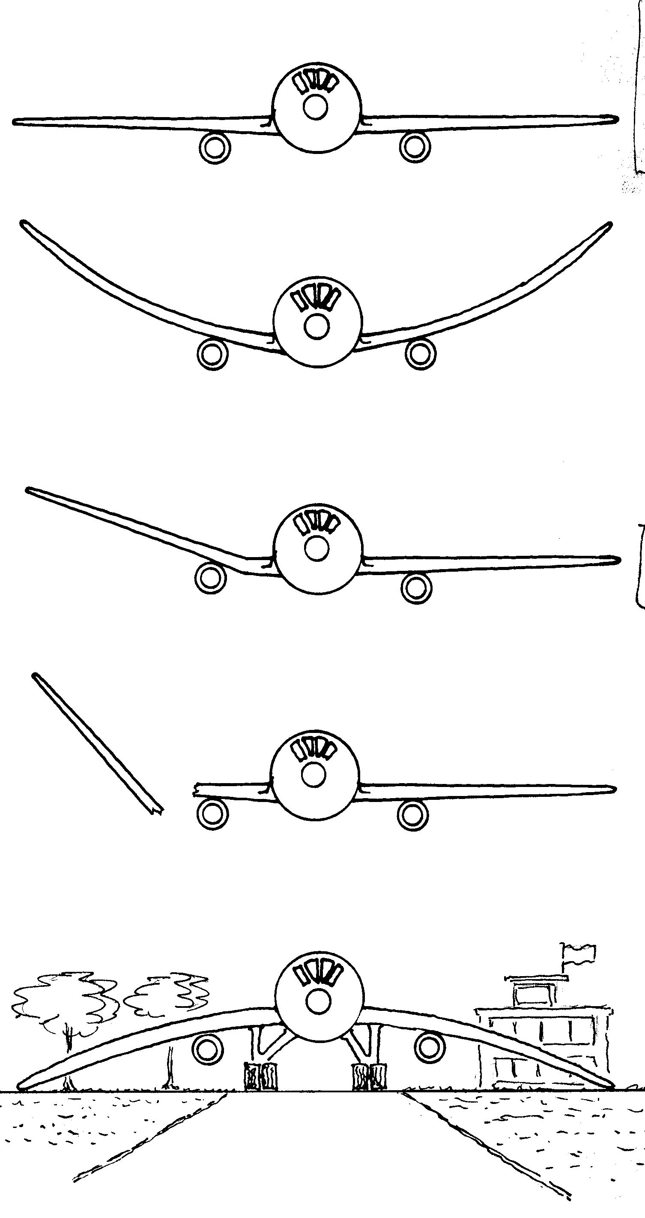
Mechanical properties illustrated
Stiff
Strong
Tough
Light
Not stiff enough (need bigger E)
Not strong enough (need bigger σ_{y} )
Not tough enough (need bigger K_{ic})
Too heavy (need lower ρ)
All OK !
Unit 1, Frame 1.6

Slide 4
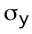
Basic material properties
Mechanical properties
Thermal expansion
General
Weight: Density ρ, Mg/m³
Expense: Cost/kg C_{m}, $/kg
Mechanical
Stiffness: Young’s modulus E, GPa
Strength: Elastic limit σ_{y} , MPa
Fracture strength: Tensile strength σ_{ts} , MPa
Brittleness: Fracture toughness K_{ic} , MPa.m^{1/2}
Thermal
Expansion: Expansion coeff. α, 1/K
Conduction: Thermal conductivity λ, W/m.K
Electrical
Conductor? Insulator?
Thermal strain ε
Expansion
coefficient, α
Ductile materials
Temperature, T
Elastic limit,
Thermal conduction
Stress σ
x
Young’s modulus, E
T₁
T_{o}
Strain
Area A
Q joules/sec
Brittle materials
∗
Tensile (fracture)
strength,
Heat flux, Q/A
Stress σ
∗
Thermal
conductivity, λ
Young’s
modulus, E
(T₁ ₋T₀)/x
Strain
Unit 1, Frame 1.5

Slide 5
Material property- charts: Modulus - Density
1000
Ceramics
100
Composites
10
Woods
Young’s modulus E, (GPa)
Metals
1
Foams
Polymers
0.1
Elastomers
0.01
0.1
1
10
100
Density (Mg/m³)
Unit 1, Frame 1.16

Slide 6
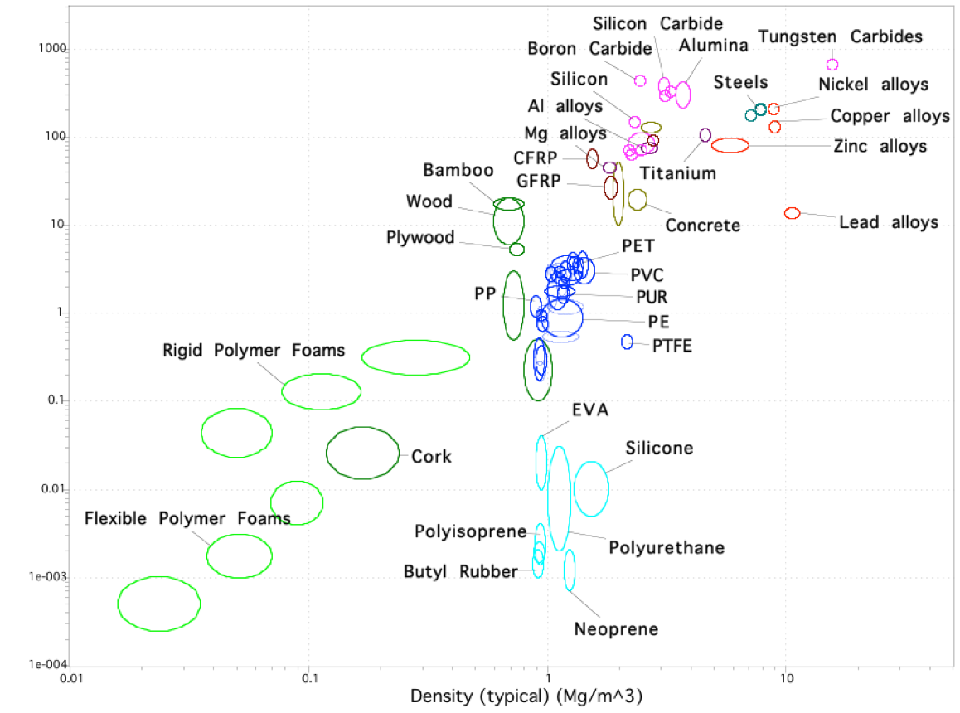
Modulus - Density
Young’s modulus (GPa)
Density (g/cm³)
Unit 1, Frame 1.18

Slide 7
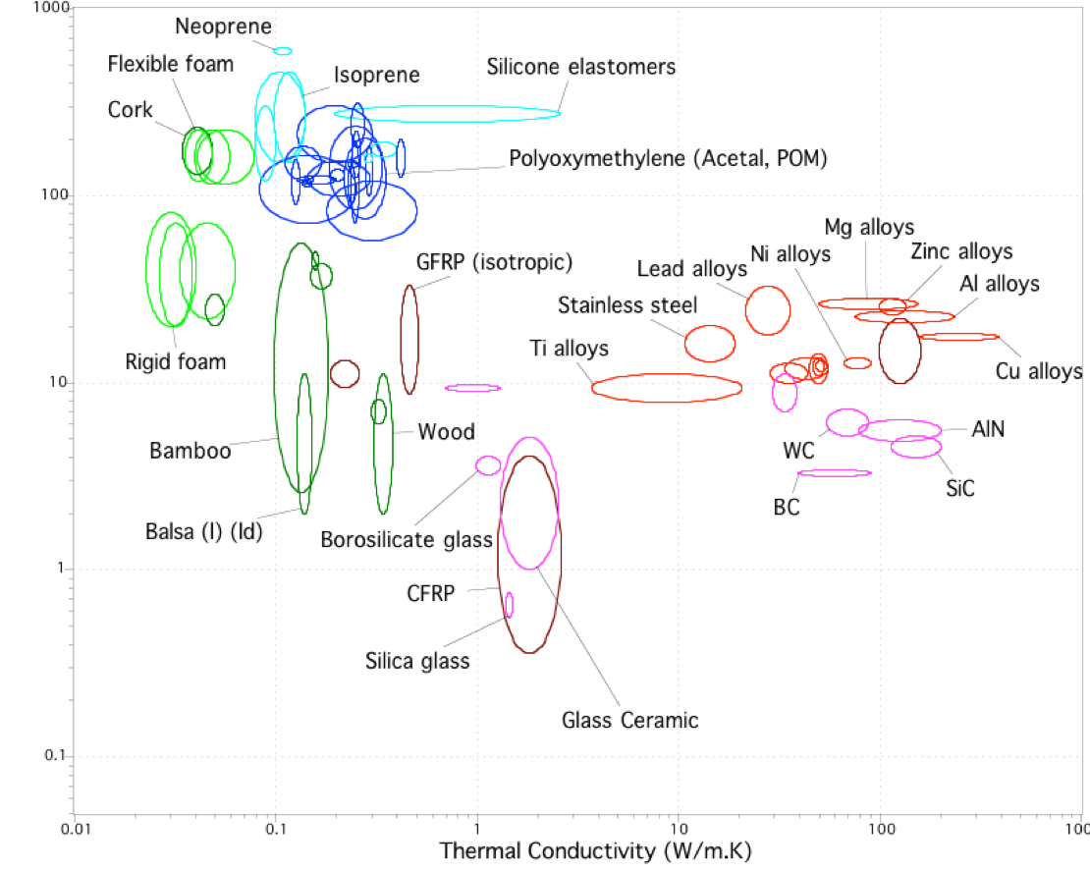
Thermal expansion (10⁻⁶/K)
Conductivity -
Expansion
Thermal conductivity (W/m.K)
Unit 1, Frame 1.20

Slide 8
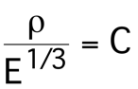
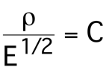
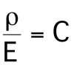
Optimised selection
panel
beam
tension
1000
Ceramics
100
Composites
Woods
10
Young’s modulus E, (GPa)
1
Metals
1
2
3
Polymers
0.1
For beam bending,
Contours of constant
C are lines of slope 2
on an E-ρ chart
Foams
Elastomers
0.01
0.1
1
10
100
Density (Mg/m³)

Slide 9
Search
area
Young’s modulus (GPa)
Density (Mg/m³)
Unit 2, Frame 2.15

Slide 10
Oars: real life
Wood: Sitka spruce, quartered and laminated
CFRP: Tailored to rower’s specification
Young’s modulus (GPa)
Density (Mg/m³)
Unit 2, Frame 2.15

Slide 11

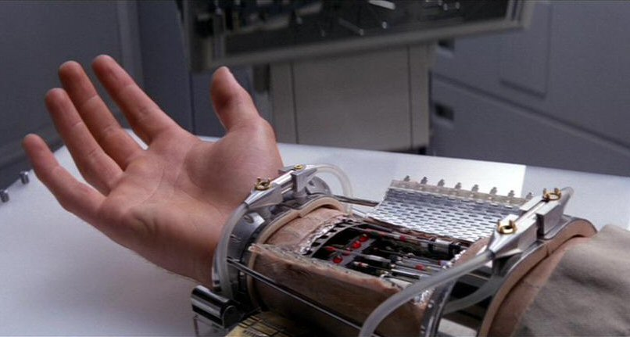


Bionic Devices in Science Fiction
Luke Skywalker, 1980
Steve Austin, 1974
http://www.youtube.com/watch?v=HofoK_QQxGc
1972
1984

Slide 12
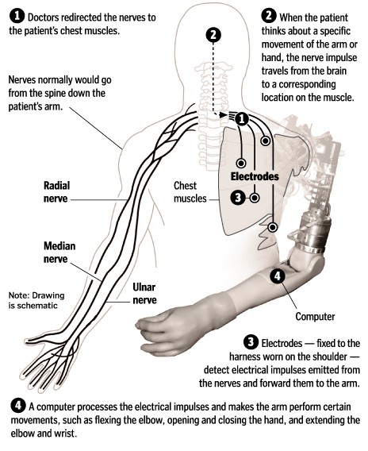
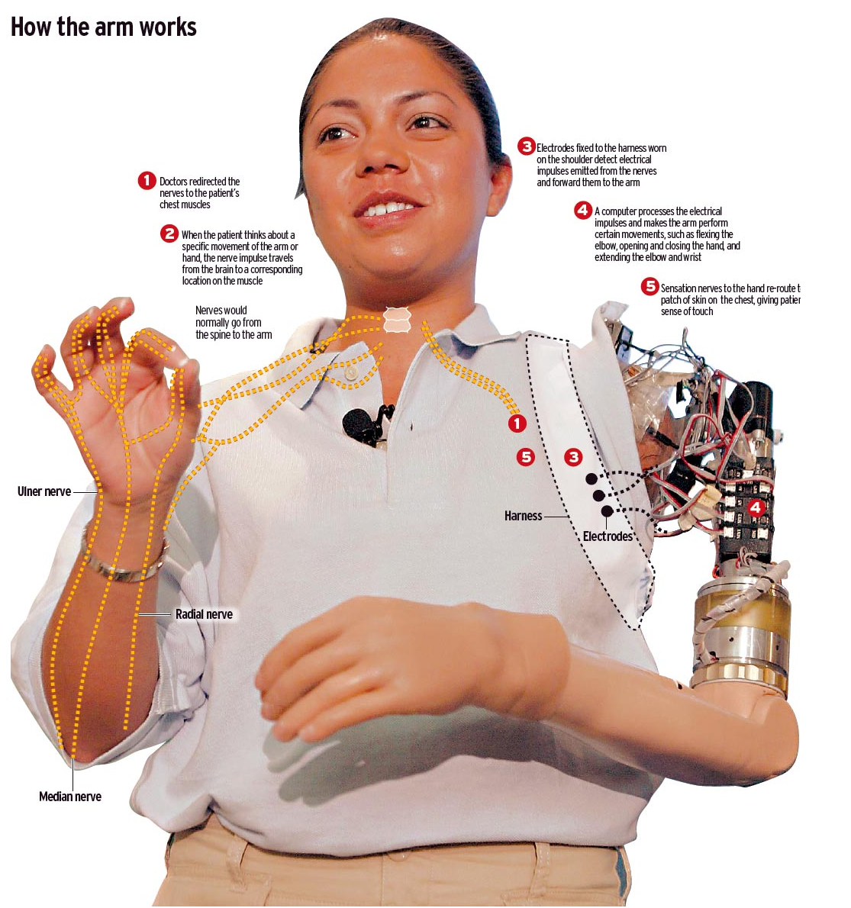
Integrated Bionic Prosthesis
Former U. S. Marine Claudia Mitchell: http://www.youtube.com/

Slide 13
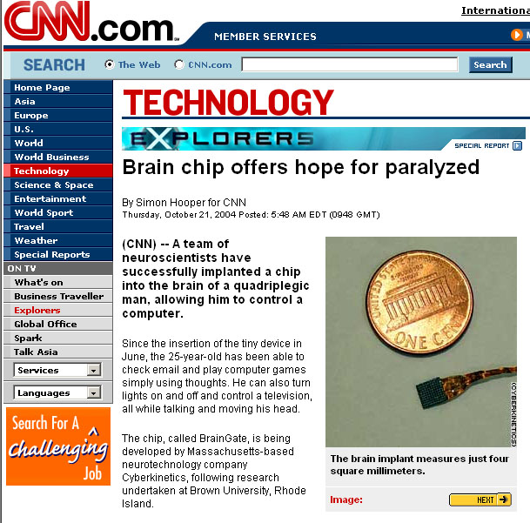
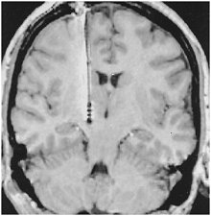
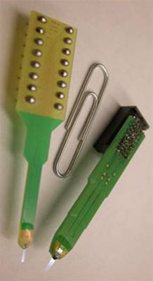
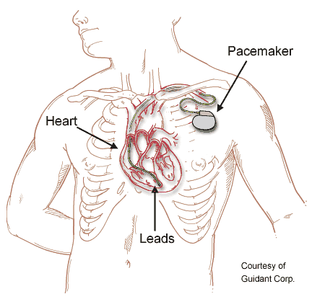
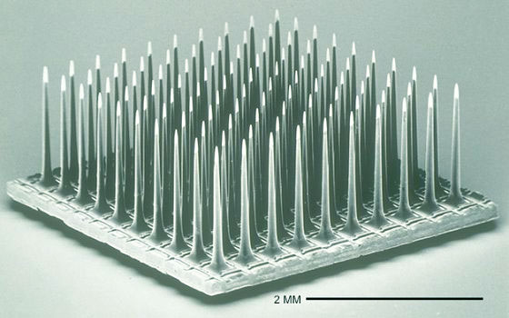
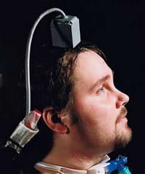
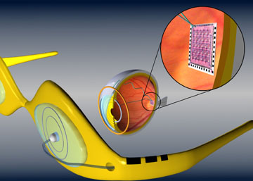
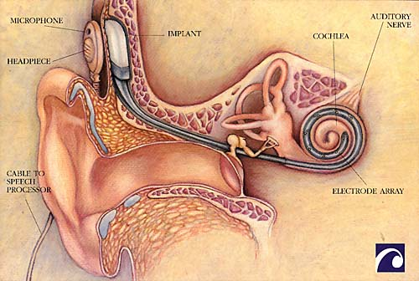
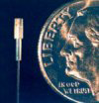
Bionic devices: solid electronic wire – wet ionic tissue interfaces
DBS electrode
Utah MEA
Implantable
glucose
sensor +
insulin pump
Michigan CNCT
NeuroNexus
CyberKinetics
Second Sight Retinal Implant
Cochlear Electrode

Slide 14
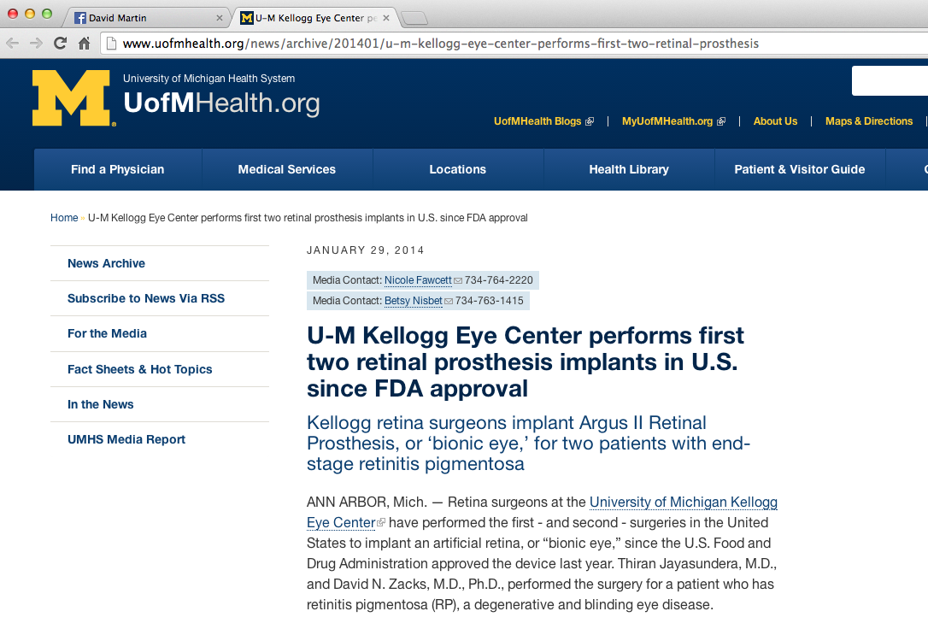
Second Sight: 2-sight.eu

Slide 15
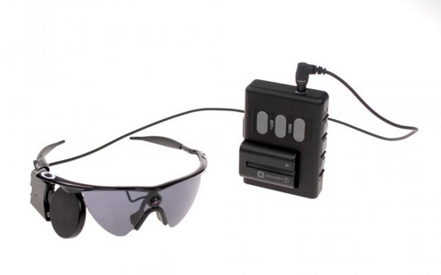
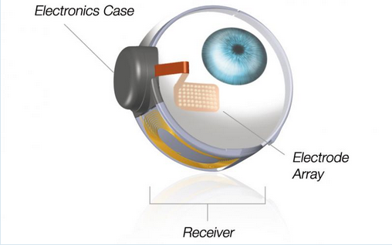
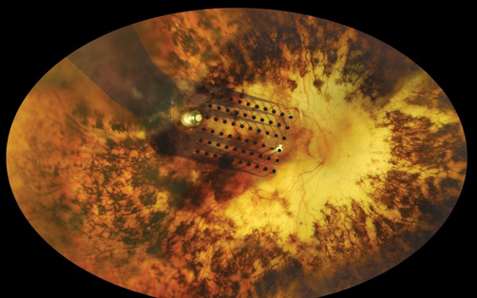

Slide 16
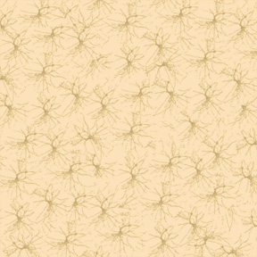
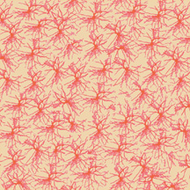
Electrode-Tissue Interfaces
Major Road Blocks
Foreign body reaction
Device biofouling, eventual failure
Signal blocking glial scar/encapsulation
Loss of proximal neurons
Biomaterials Design
Mechanical Properties
Hard to Soft
Bioactivity
Inert to Living
Electronic Transport
Electronic to Ionic
Surface Topography
Flat to Articulated
Permeability
Solid to Wet Network

Slide 17
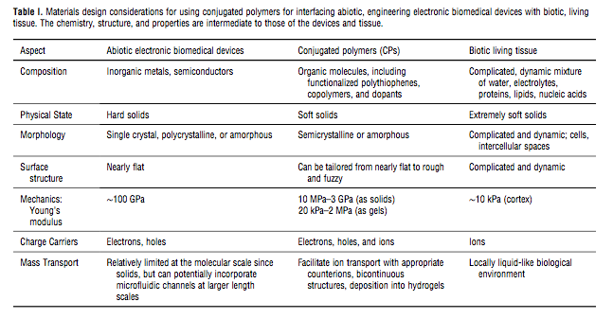
Abiotic Devices : Conjugated Polymers : Living Tissue

Slide 18
Modulus-Resistivity Map
Soft
Insulating
Stiff
Insulating
Resistivity (Ohm-meters)
Soft
Conducting
Stiff
Conducting
CES Selector 4.6.1, Granta Design, (2006)

Slide 19
Modulus-Resistivity Map
Soft
Insulating
Stiff
Insulating
Rubber
Bands
Plastic
Bottles
Foam
Cushions
Rocks
Resistivity (Ohm-meters)
Computer
Chips
Wires
Soft
Conducting
Stiff
Conducting
CES Selector 4.6.1, Granta Design, (2006)

Slide 20
Modulus-Resistivity Map
Soft
Insulating
Stiff
Insulating
Rubber
Bands
Plastic
Bottles
Foam
Cushions
Rocks
Resistivity (Ohm-meters)
Computer
Chips
Tissue
Wires
Soft
Conducting
Stiff
Conducting
CES Selector 4.6.1, Granta Design, (2006)

Slide 21
Modulus-Resistivity Map
Soft
Insulating
Stiff
Insulating
Rubber
Bands
Plastic
Bottles
Foam
Cushions
Rocks
Resistivity (Ohm-meters)
Computer
Chips
PEDOT
Tissue
Wires
Soft
Conducting
Stiff
Conducting
CES Selector 4.6.1, Granta Design, (2006)

Slide 22
Modulus-Resistivity Map
Soft
Insulating
Stiff
Insulating
Rubber
Bands
Plastic
Bottles
Foam
Cushions
Rocks
Resistivity (Ohm-meters)
Computer
Chips
PEDOT in Gels, Tissue
PEDOT
Tissue
Wires
Soft
Conducting
Stiff
Conducting
CES Selector 4.6.1, Granta Design, (2006)

